Slide 1
CS4760, HU4628, CS5760
KK’s UCD NOTES--16 Jan 2020

Slide 2
What to read… where my thoughts come from
Lecture on User Centered Design https://cs4760.csl.mtu.edu/2020/lectures/user-centered-design/
User Centered Design information from usability.gov
Basics https://www.usability.gov/what-and-why/user-centered-design.html
Benefits https://www.usability.gov/what-and-why/benefits-of-ucd.html
Process map https://www.usability.gov/how-to-and-tools/resources/ucd-map.html

Slide 3
Key concepts from UCD Lecture
Common software development processes outlined in lecture notes
Waterfall process
Iterative process
More or less complex and detailed depending on context
Even if you don’t know the terms, you probably have followed processes like these.
Familiarize yourselves by reading the lecture if you haven’t already done so.

Slide 4
Discuss the following questions at your table
What are some differences between the Waterfall and User-Centered design process?
Why is awareness of these differences important when you’re designing a user interface?

Slide 5
User-centered Design Process
Concentrates on user, not data or apparatus/product; the general process, which we will follow, includes these steps (many of which will be iterative)
Needs analysis
conversation with client;
heuristic evaluation
User analysis
persona development
Task analysis
scenario development
Functional analysis
Computer process? human?
Requirement analysis
What MUST it do? WHY? For whom?
Setting usability specifications
Prototyping and testing

Slide 6
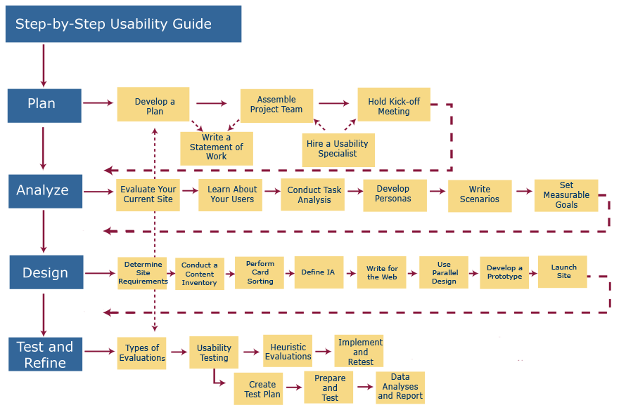
https://www.usability.gov/how-to-and-tools/resources/ucd-map.html

