Slide 1
Graphics Design
Robert Pastel
Figures of this lectures are from McCracken and Wolfe, “User-Centered Website Development”

Slide 2
Gestalt
What is does it mean?

Slide 3
Gestalt
German for “shape”
Psychology for “a form or configuration having properties that cannot be derived by the summation of its component parts”
In other words, “The sum is more than the individual parts

Slide 4
Gestalt Design Principles
What are they?

Slide 5
CRAP
Contrast
Repetition (Consistency)
Alignment
Proximity
We will go through examples of each principle. Remember they are used in combination.

Slide 6
Proximity
Related items should be close to each other.
Unrelated items should be distant.

Slide 7
List for a Clothing Website Links?
checkout
close out on pink socks
Email us
July specials
Kid’s clothes
Men’s clothes
Open an account
Sale on rainwear
Special sizes
Store locations
your account status
Women’s clothes
Does it make sense? Does it has organization?

Slide 8
Better List Order?
Women’s clothes
Men’s clothes
Kid’s clothes
Special sizes
July specials
Sale on rainwear
close out on pink socks
Store locations
Store hours
Open an account
your account status
Checkout
Email us
Better, why?

Slide 9
Alignment
Can be vertical or horizontal
Left, right or center justification
Alignment suggests a relationship between items.
Less jags or breaks, generally better design.

Slide 10
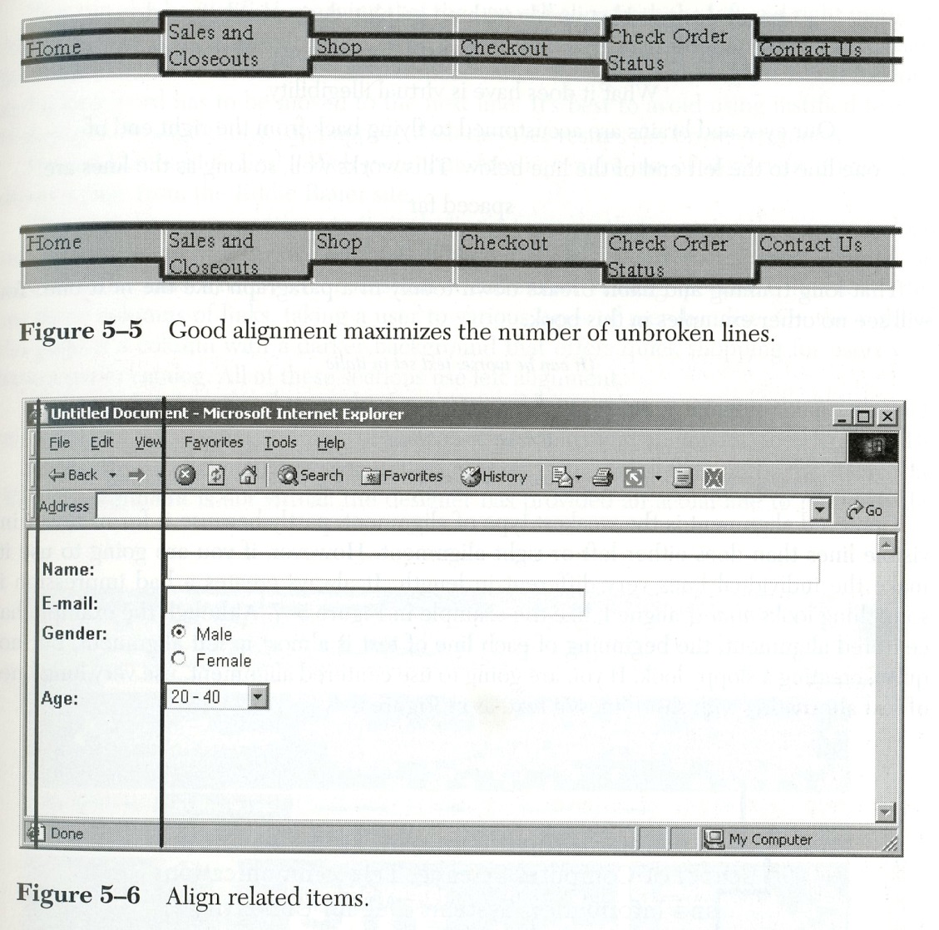
Alignment means less jags

Slide 11
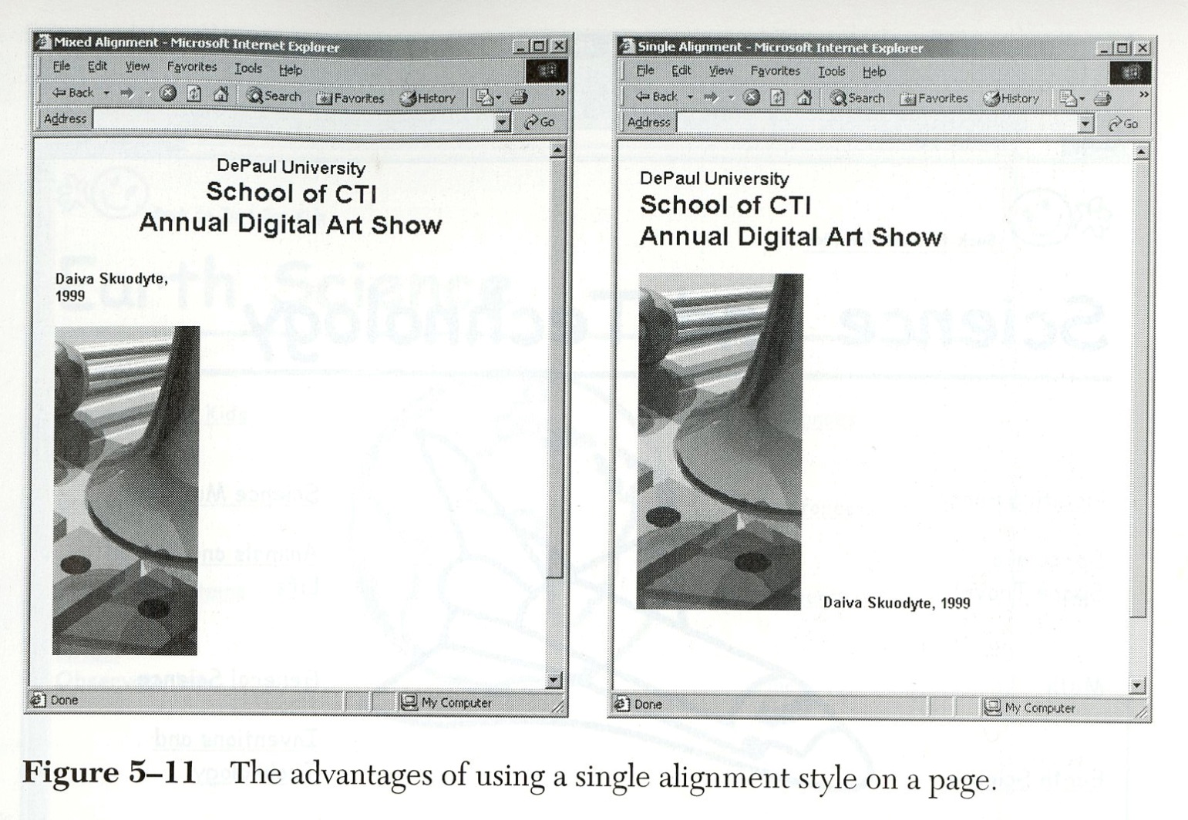
Single Alignment
Which do you prefer? Why?

Slide 12
Center Justification
Women’s clothes
Men’s clothes
Kid’s clothes
Special sizes
July specials
Sale on rainwear
close out on pink socks
Store locations
Store hours
Open an account
your account status
Checkout
Email
Does center justification work?

Slide 13
Center Justification
The Title of Some Large Work
Joe Writer
Does this work? Why? What does it mean?

Slide 14
Consistency or Repetition
Consistency within the page also enhances grouping
Consistency across the web pages can assure users that they are browsing the same web site
Consistency across the app views assures the sure that they are in the same app

Slide 15
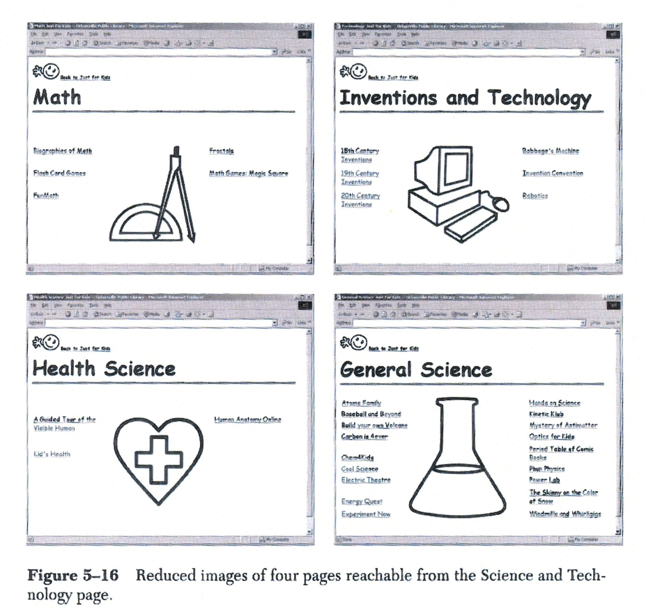
Consistency of Webpage Design

Slide 16
Contrast
Contrast can be used to separate items.
McCracken suggests making the font contrast large
I find that high contrast in color can be distracting, and excessively large fonts waste space, a premium on most screens
“A little contrast can go a long way”

Slide 17
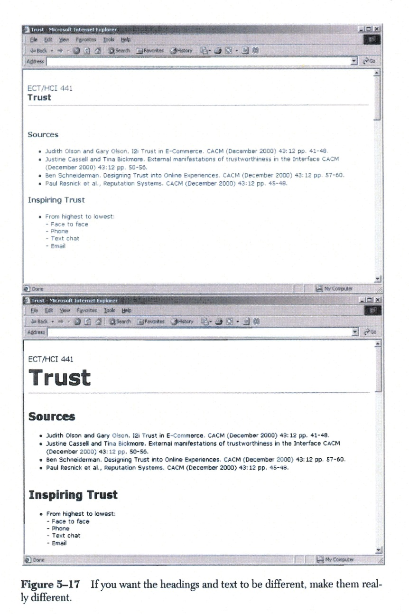
Contrast in Font

Slide 18
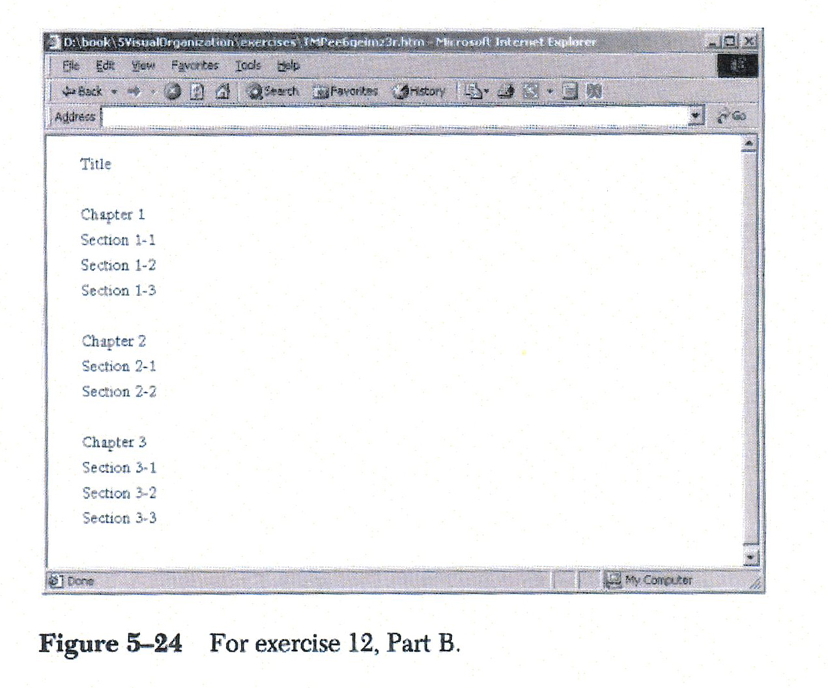
Test: what Gestalt principles?
Is it enough?

Slide 19
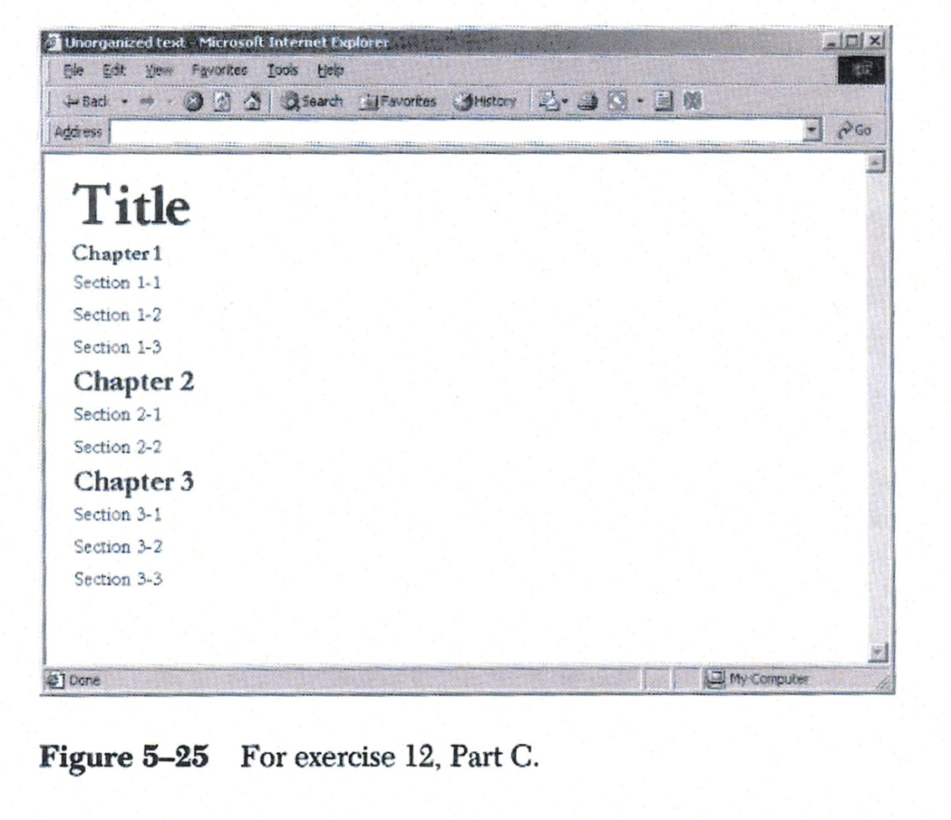
More tests: What principles?
Better? Are there more principles to use?

Slide 20
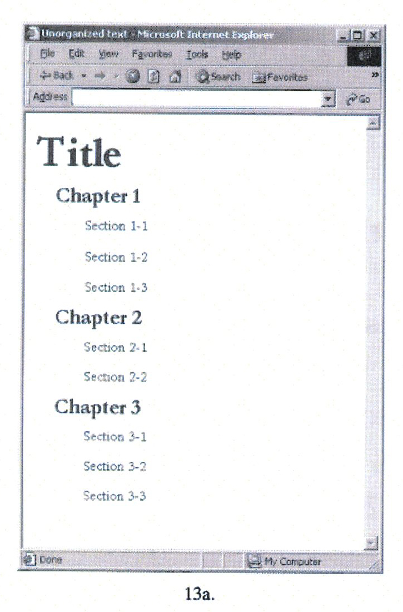
Even more tests
Is this appropriate? Why?

Slide 21
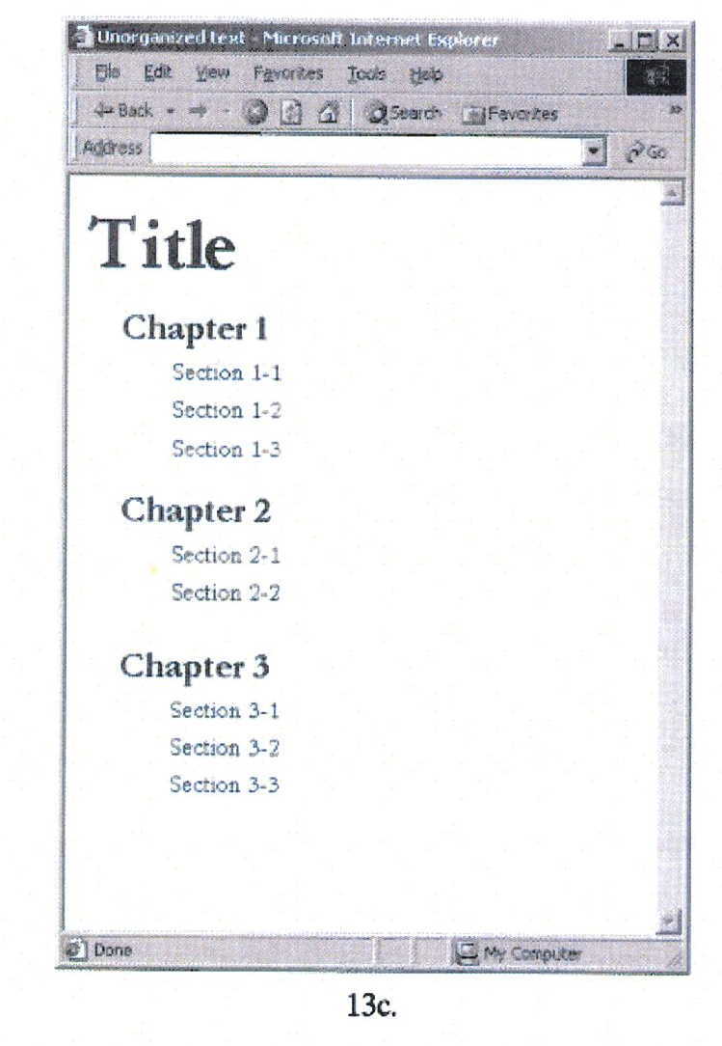
Test: What is the difference?

Slide 22
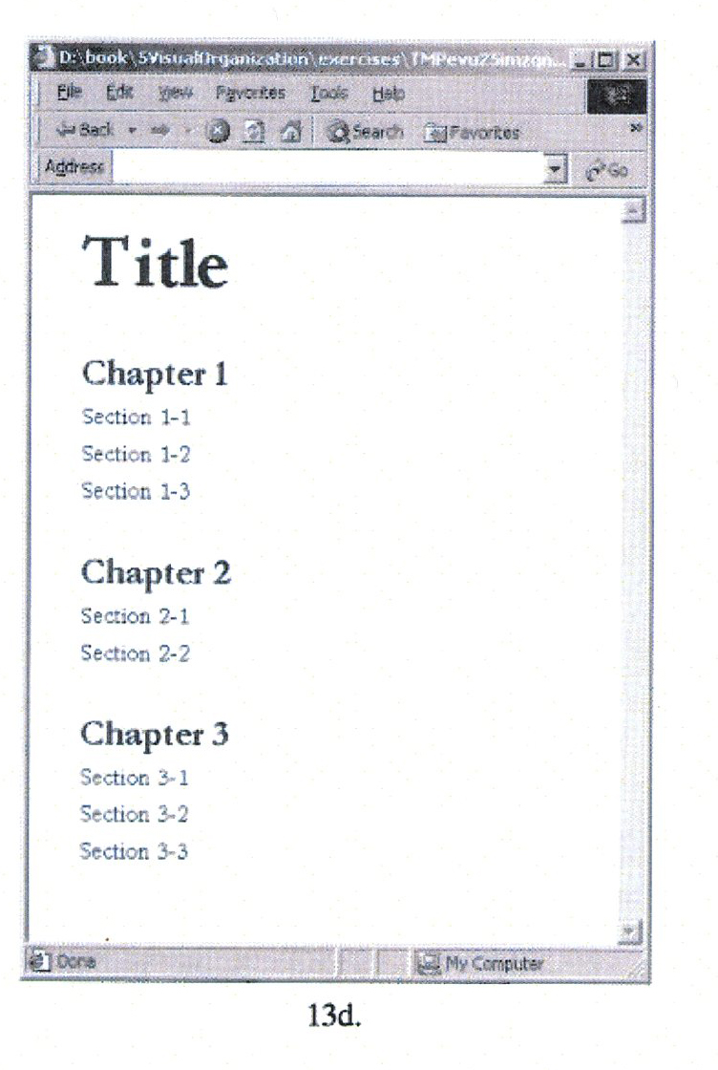
Do you prefer this?
Why?

Slide 23
Color
Color can be used to add attractiveness and usability to the interface
Color can be used to group items, and give hints at the function of buttons

Slide 24
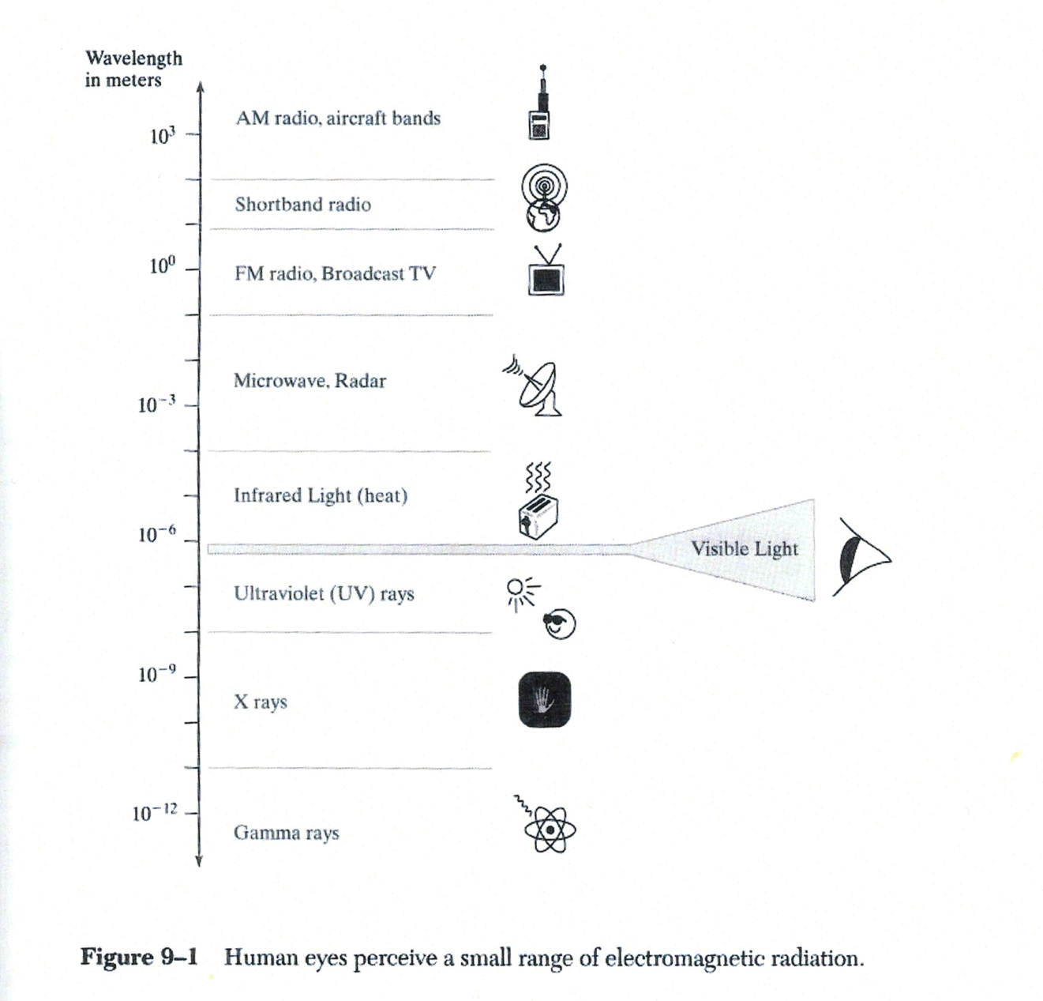
Physics of Color
Visible light is of the electromagnetic spectrum.

Slide 25
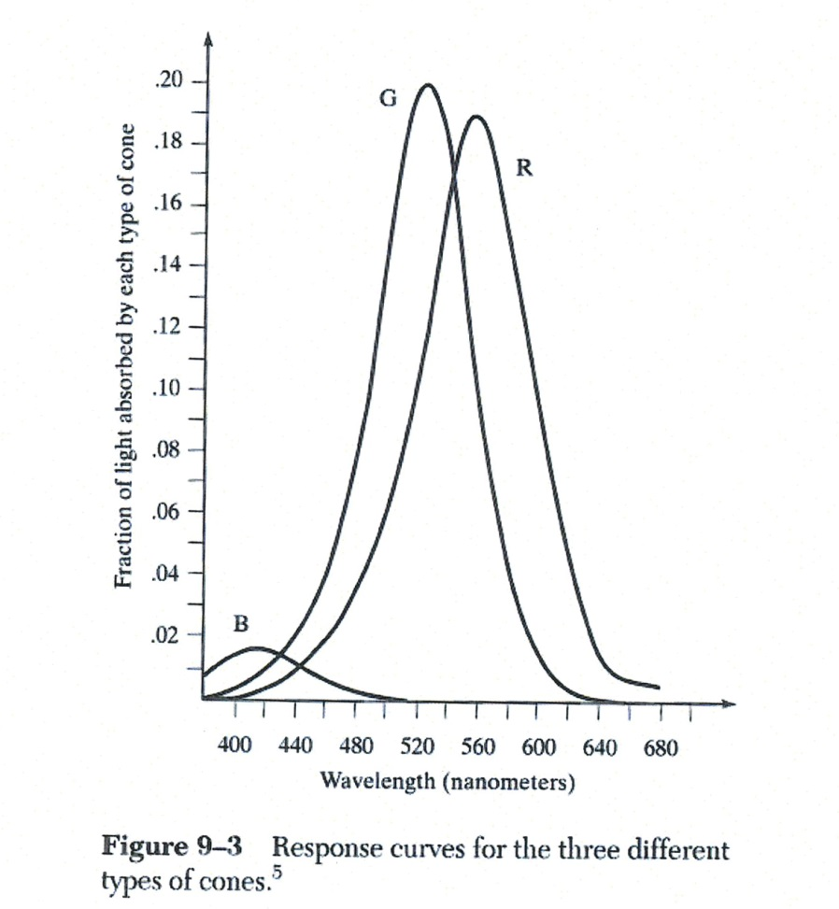
Biology of Color
Three cones: Blue, Green and Red.
Where are they located on the retina?
What are rods?

Slide 26
Color Models
Color models attempt to categorize the color quantitatively.

Slide 27
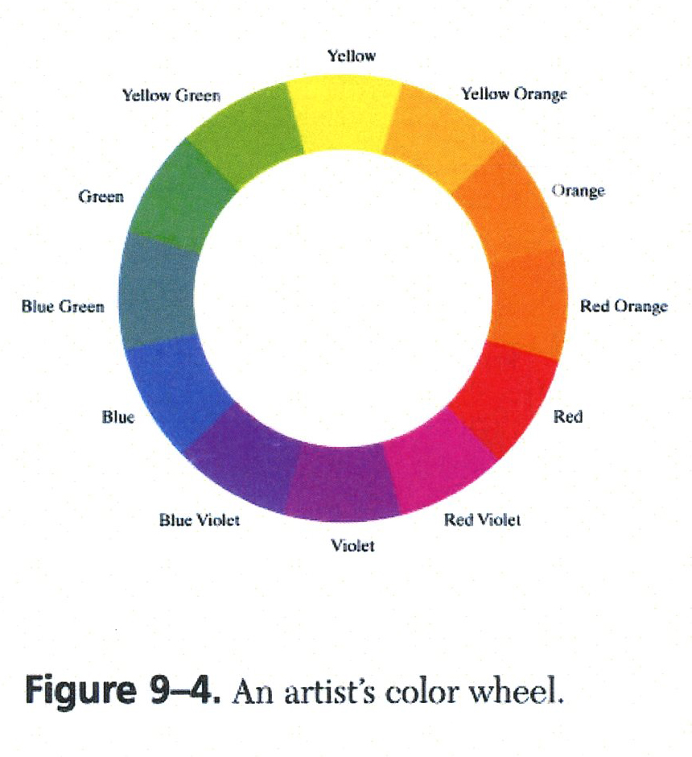
The Primaries: Red, Yellow, Blue (RYB)
Used by artist.
1613, Francis Aguilon, mix all three to get black
How is the color made?

Slide 28
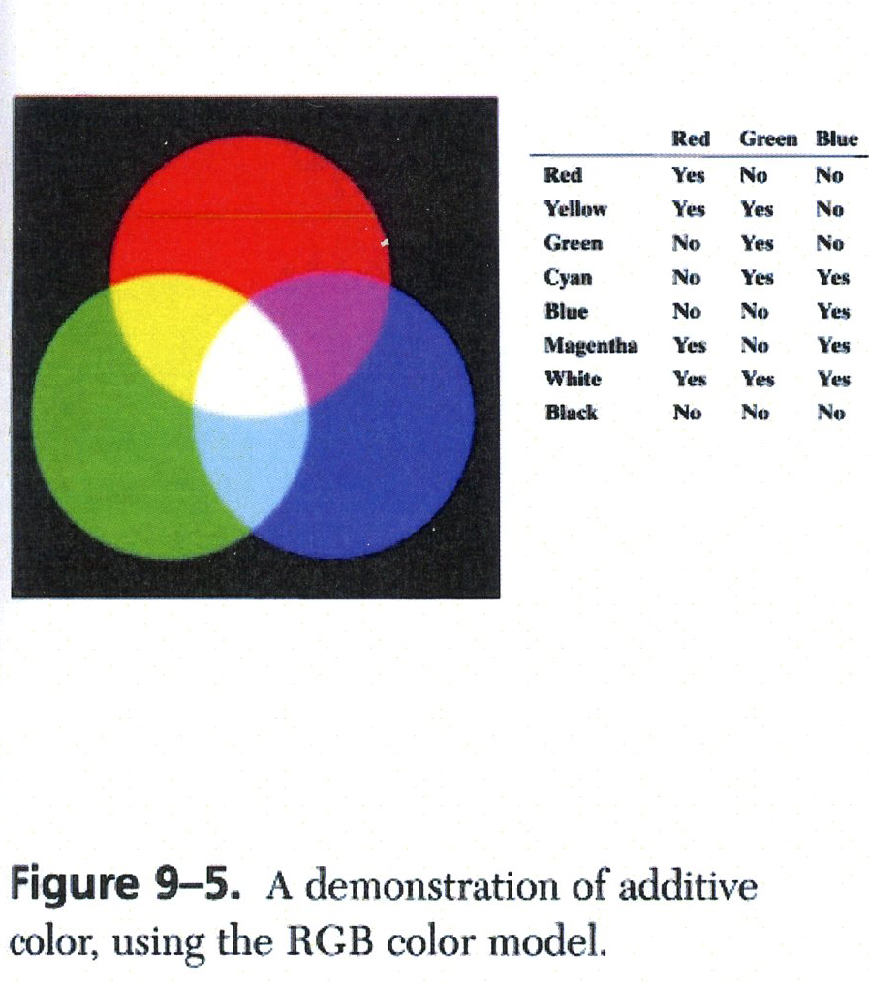
Additive Color: Red, Green, Blue (RGB)
Used by stage lighters
Principle emitted by diodes in the monitor
Colors of the web page.

Slide 29
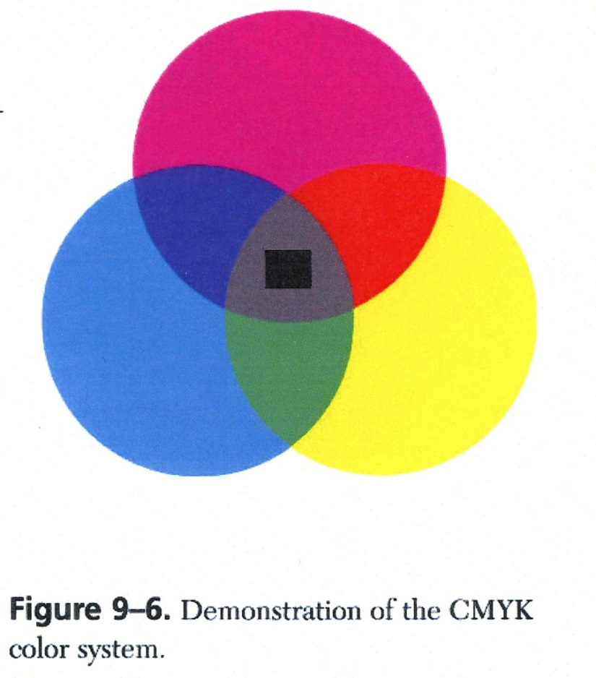
Subtractive Color: Cyan, Magenta, Yellow (CMYK)
Used by printers, the most intense dyes
Complements to red, green and blue.
So cyan subtracts red, magenta subtracts green, and yellow subtracts blue.

Slide 30
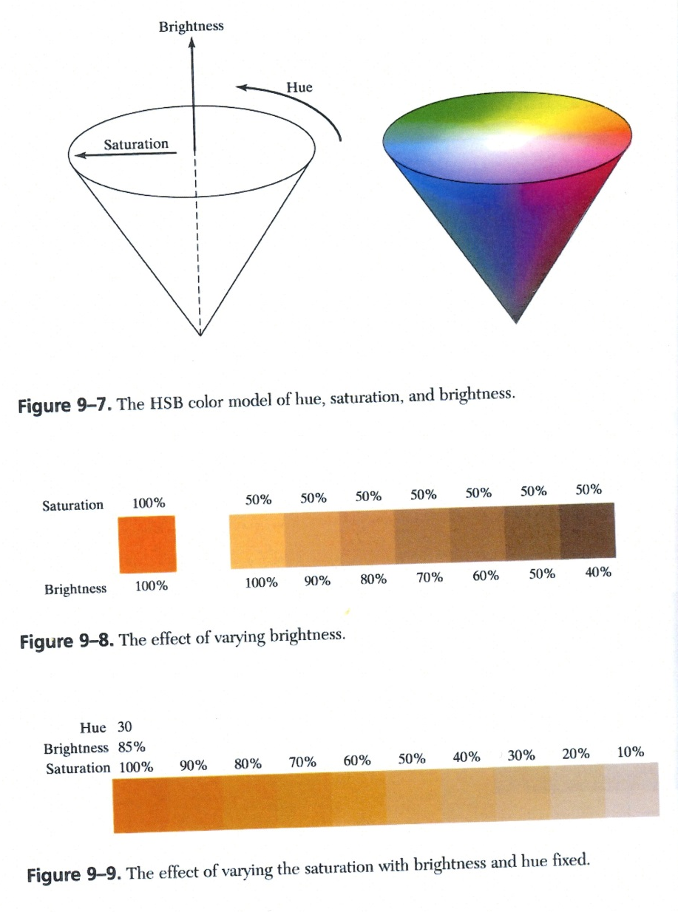
Hue, Saturation, Brightness (HSB)

Slide 31
Comparing the 4 Models
RGB system is similar to the monitor. But hard to use.
CMYK is appropriate for printed matter.
HSB system is intuitive, but is not tied to hardware.
Color systems are not synonymous. Each has a slightly different gamut.

Slide 32
Color-Harmony Schemes
Selection of colors that are used on a page
Some harmonies are harder to use then others
A color scheme will affect the message of the page

Slide 33
Monochrome
Color scheme that uses colors from the same hue
the simplest, and naturally increases the cohesion of the page
The choice of the color will have effect on the viewer

Slide 34
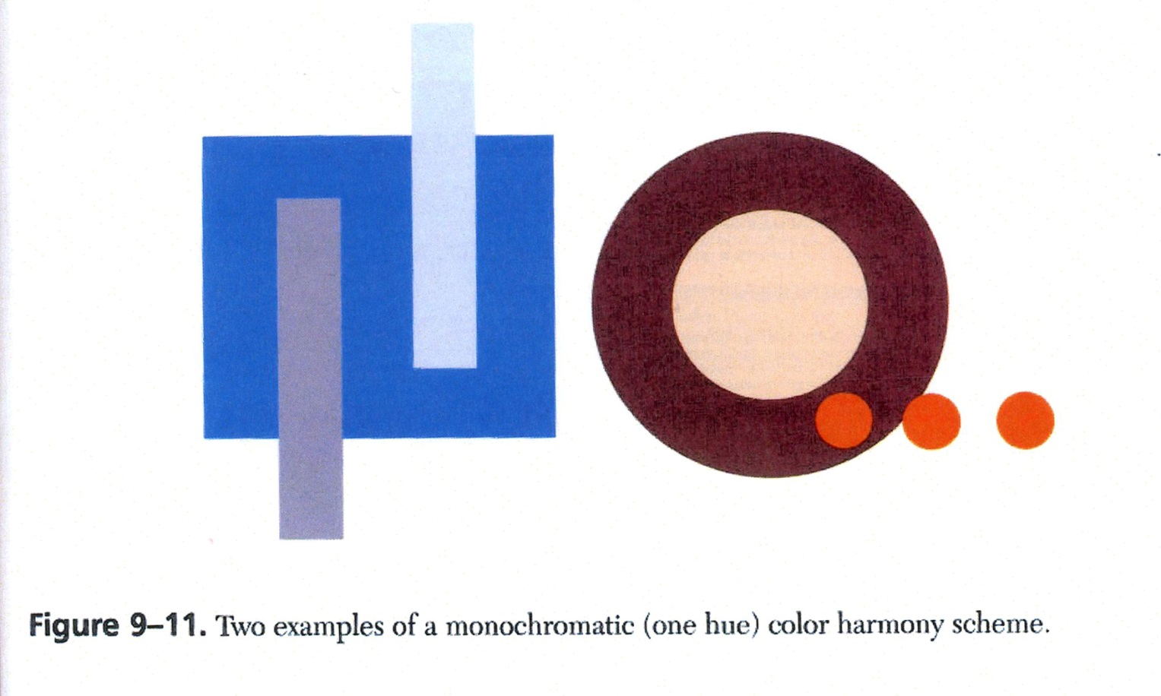
Monochrome: Red or Blue

Slide 35
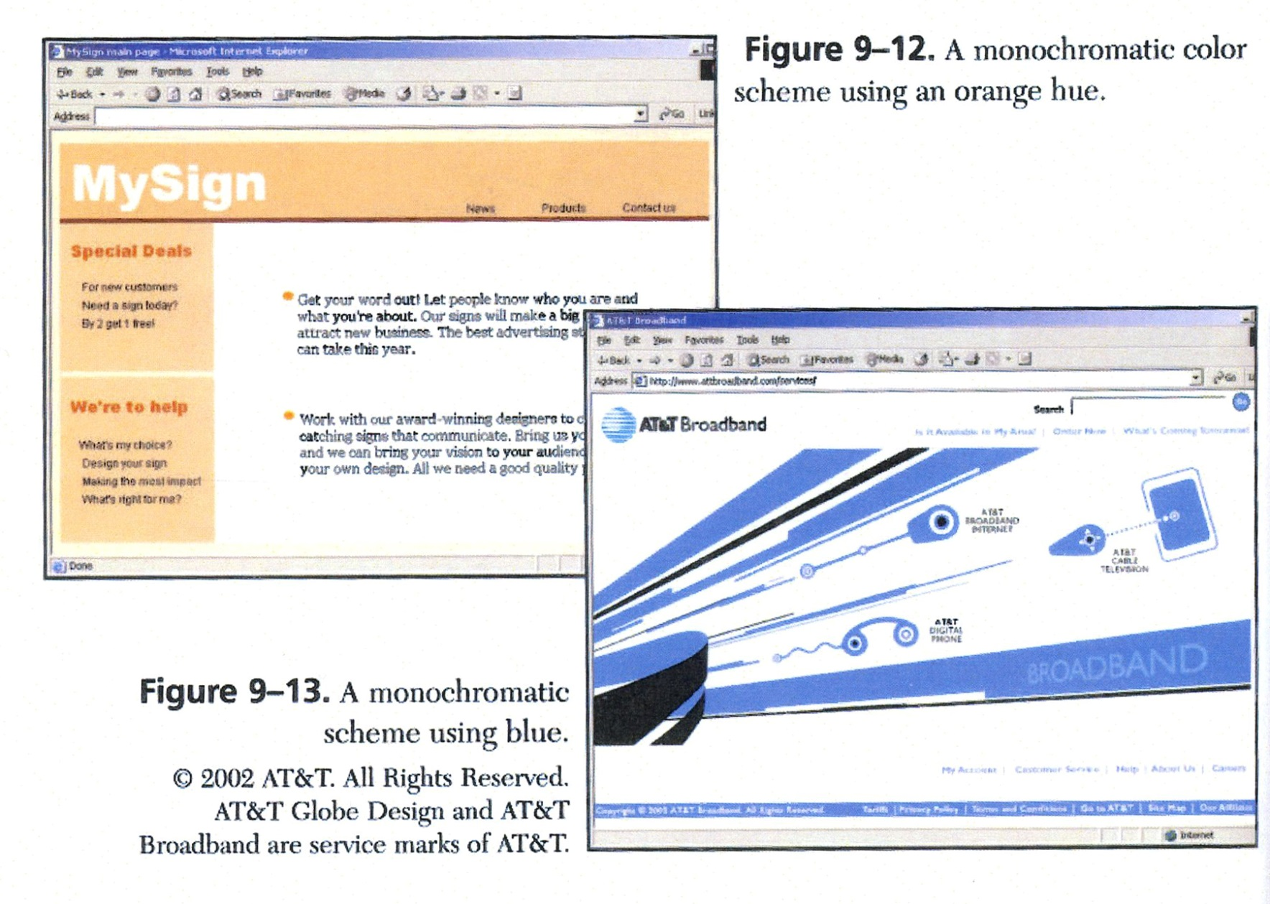
Monochrome Webpages

Slide 36
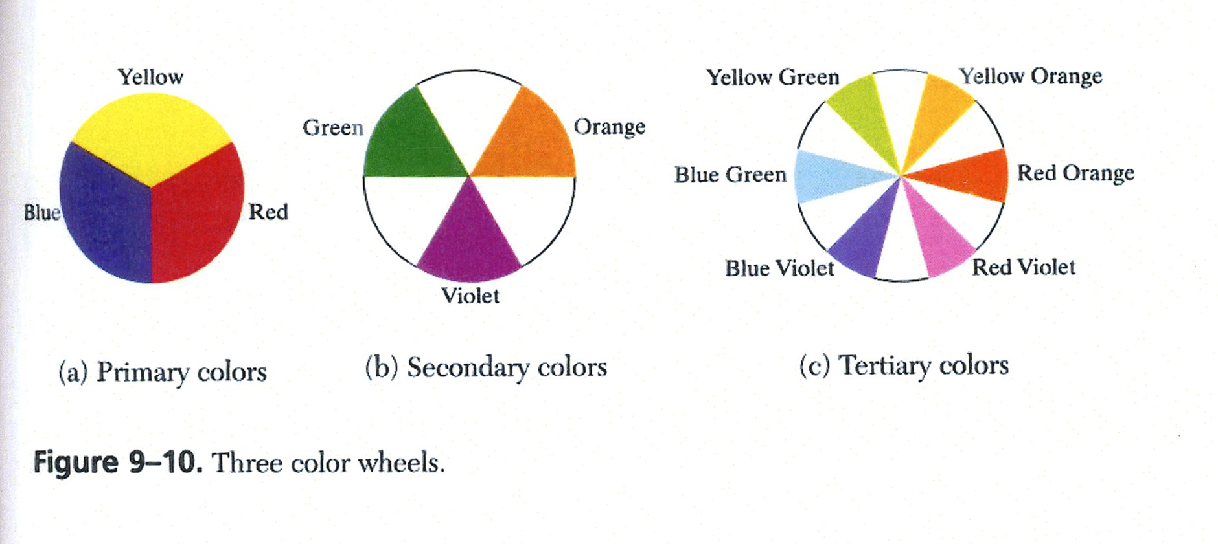
Color Wheel
What are complementary colors?
What are analogous colors?

Slide 37
Complementary Schemes
Two hues on opposite end of the color wheel
Increases contrast in the page
Avoid clashing by having one hue be the dominated color
Seldom have adjacent complementary color at full saturation.

Slide 38
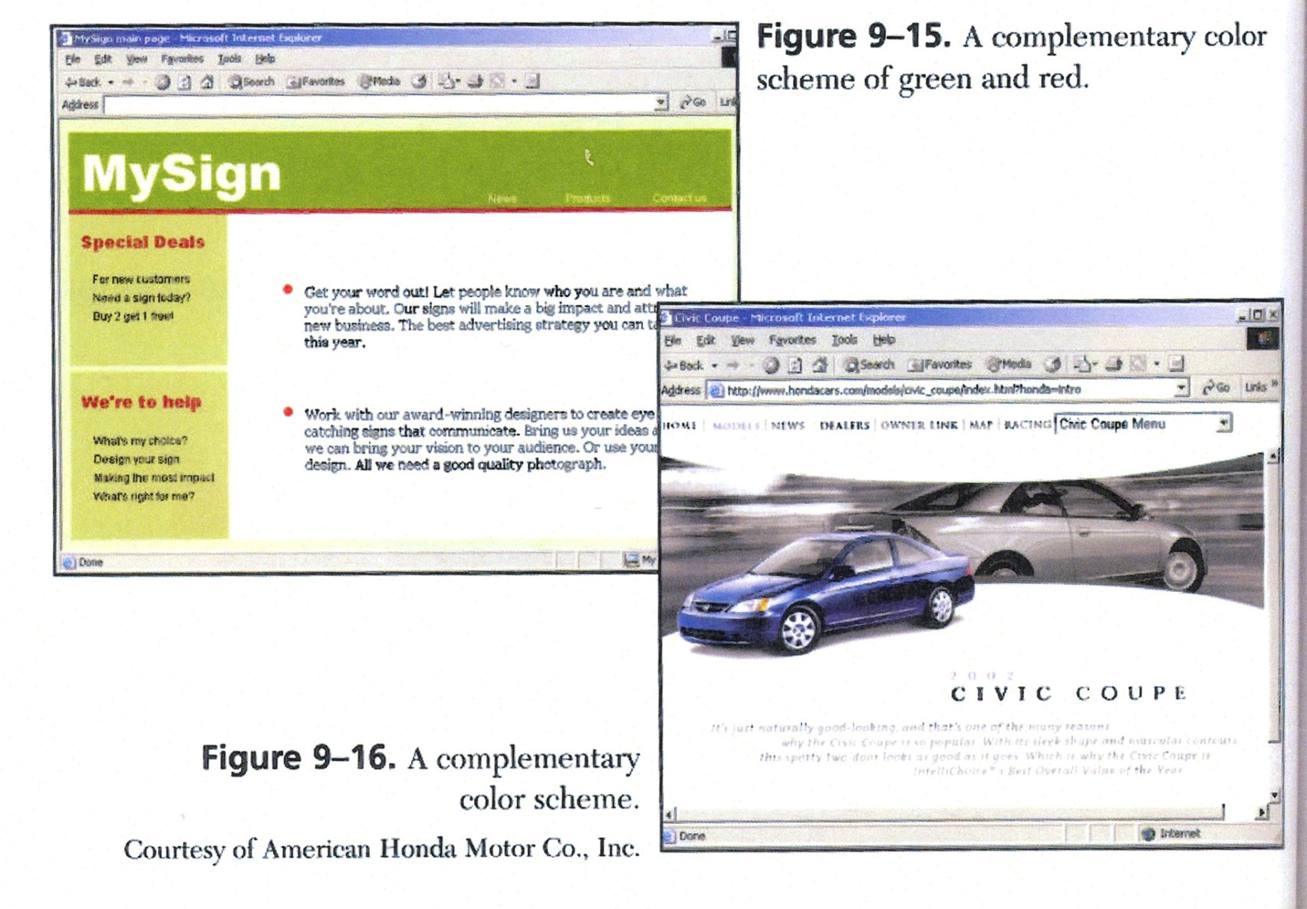
Complementary Webpages

Slide 39
Analogous Schemes
Two colors close to each other
Frequently found in nature
Analogous scheme is frequently pleasing

Slide 40
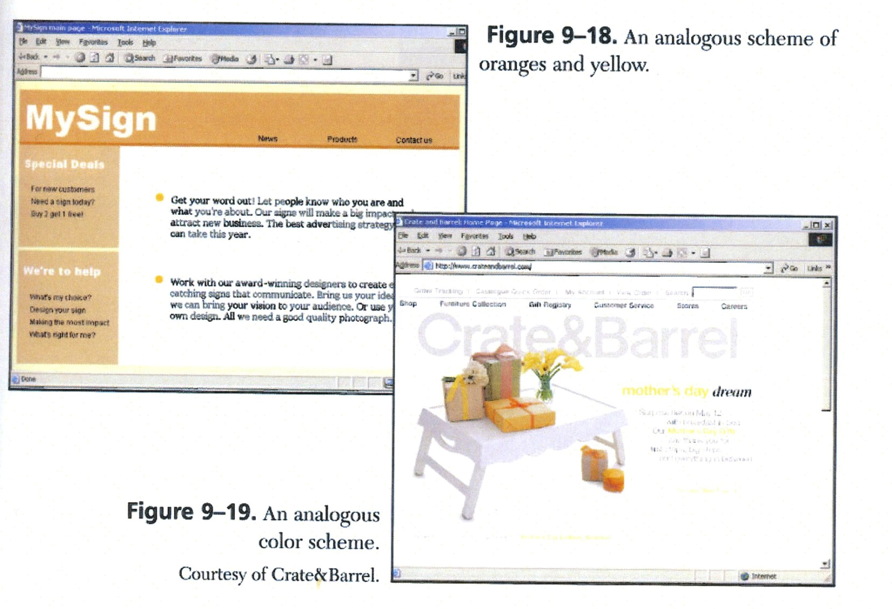
Analogous Webpages

Slide 41
Triadic Color Schemes
Three hues approximately equally spaced around the color wheel
Colorful, but can easily get out of hand
If all the colors are saturated and bright the web page may look gaudy.

Slide 42
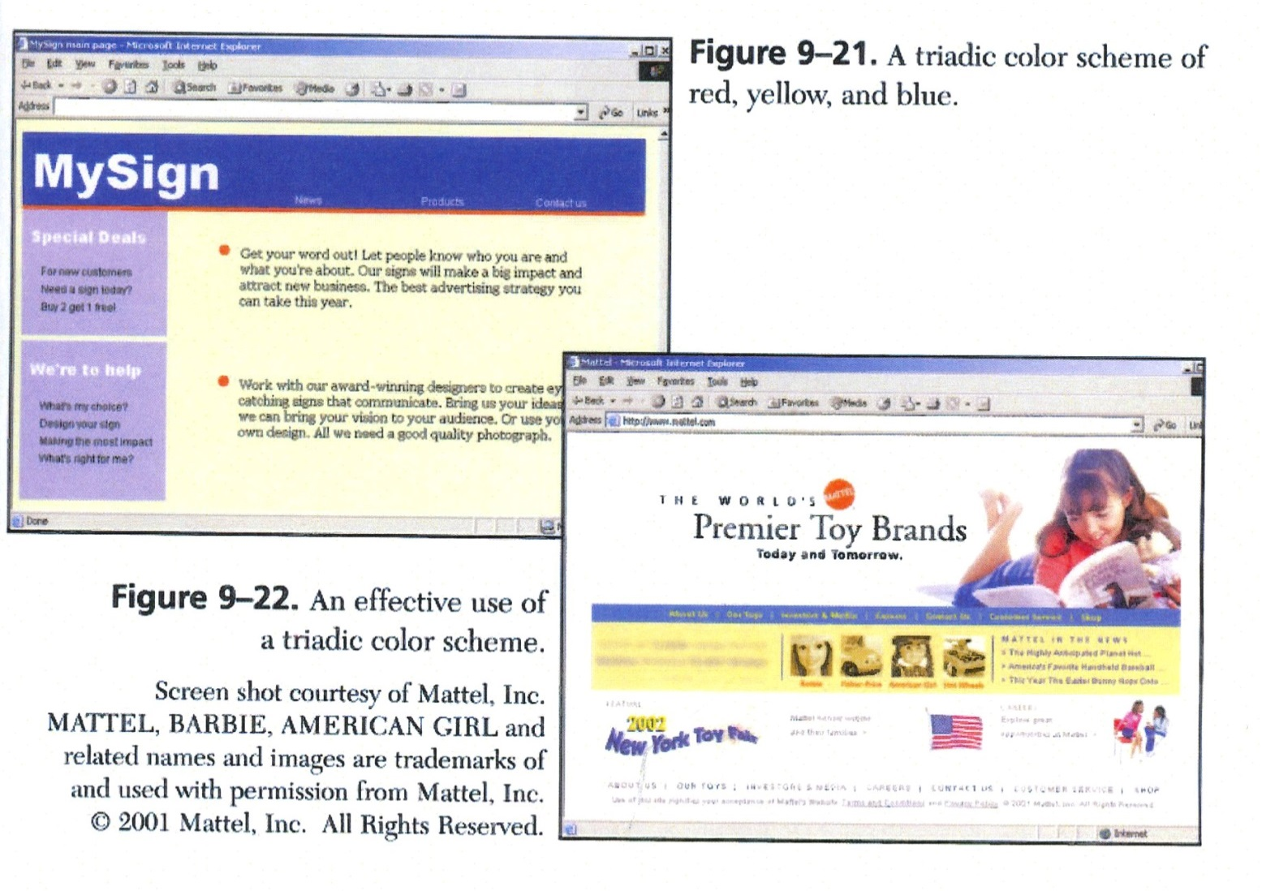
Triadic Webpages

Slide 43
Text and Background Color
Want high contrast
Dark text on light background is easiest to read
Consider yellow text on white, why does it not work?
Consider brown text on white, why is this easier?

Slide 44
Color as Organizer
Color coding can organize items into groups
Enhance proximity grouping and increase contrast
A single color will attract
Why the color of traffic lights?

Slide 45
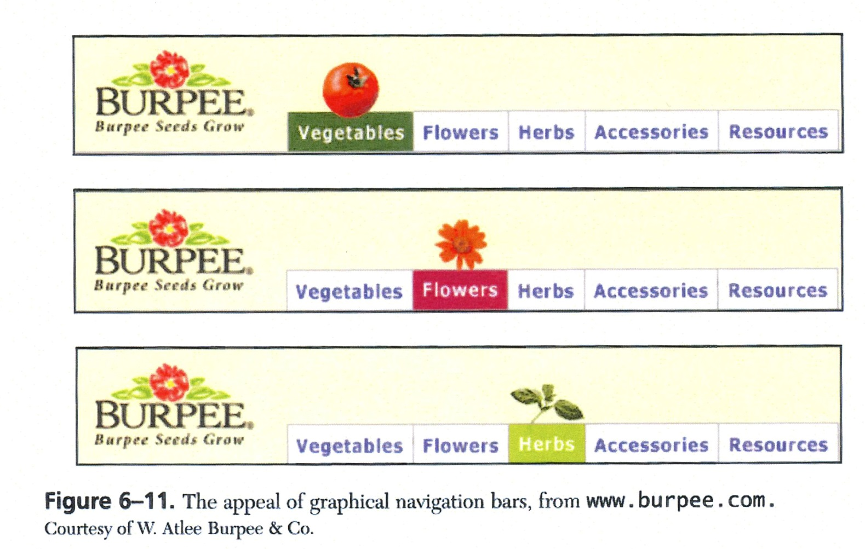
Single Color on Webpages

