Slide 1
Scenarios & Instructions
HU4628--January 21, 2020

Slide 2
What are scenarios and why do we use them?
critical both for designing an interface and for usability testing because they concretely…
describe the stories and context behind why a specific user or user group uses a product (rationale/purpose)
note the goals to be achieved and and questions to be answered by/for user
sometimes define how user(s) can achieve their goals/answer their questions
https://www.usability.gov/how-to-and-tools/methods/scenarios.html

Slide 3
How to create user scenarios
Write clearly what interaction needs to take place ... for a task to be carried out.
[Consider not only] the user’s interaction with technology, but also the other things that happen while this interaction takes place
[e.g.] include cultural information and context… plus circumstances that led the user to the product or application.
Goal is to help developers adapt their designs to improve the usability and user experience of an application.
https://pidoco.com/en/help/ux/user-scenario

Slide 4
Types of scenarios
In your group, taking MS Word as the domain, imagine an elaborated and a full-scale scenario.
Goal or task-based scenario | Elaborated scenario | Full-scale task scenario
How to insert a picture into a document with Word.

Slide 5
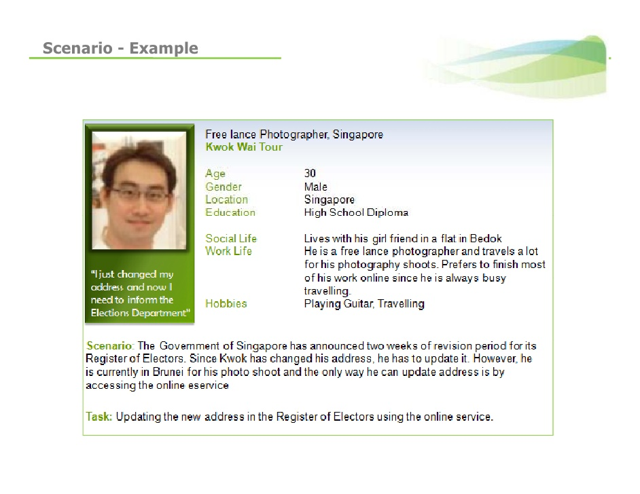

Slide 6
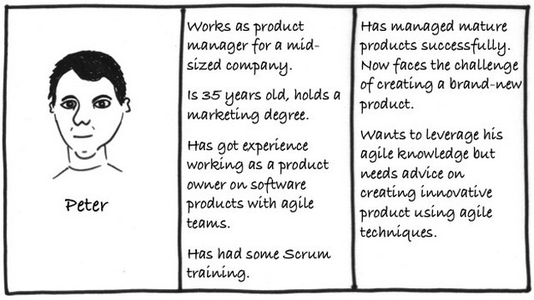

Slide 7
Personas
https://www.usability.gov/how-to-and-tools/methods/personas.html
How do personas and scenarios work together? Do they have any value as individual entities?
What thoughts do you have about using scenarios (and maybe also personas) in the design of instructions?
As you discuss this question, you might wish to google scenarios and personas and look at some of the examples that pop up.

