Slide 1
CS4760 - HU4628 - CS 5760 Stakeholder Notes
Karla Kitalong -- 14 January 2020

Slide 2
Resources for Stakeholder Analysis
http://cs4760.csl.mtu.edu/2020/lectures/project-and-stakeholders/ (CS4760/HU4628 Lecture)
http://cs4760.csl.mtu.edu/2020/resources/Onion.pdf (article on onion model)
https://owl.purdue.edu/owl/subject_specific_writing/professional_technical_writing/audience_analysis/stakeholder_considerations.html (rhetorical considerations)

Slide 3
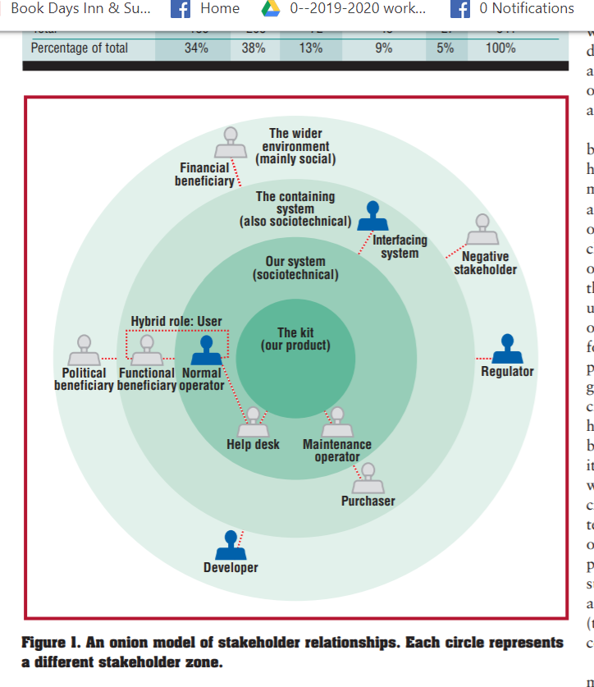
The Onion Model of Stakeholder Identification
The kit--the app, project or system. The project’s hardware, software, and documentation.
The sociotechnical system--the primary stakeholders; the explicit/known primary or secondary users.
The containing system--secondary stakeholders who use the results of the system or provide input to the system.
The wider environment , which includes tertiary stakeholders who influence the project.
Implicit or “invisible users”?

Slide 4
Discuss at your table: What’s the difference between users and stakeholders?

Slide 5
From what you know about the class projects, who might you call
Tertiary stakeholders within the wider environment?
Implicit or invisible stakeholders?

Slide 6
Defining stakeholders in professional writing (rhetorical perspective)
The stakeholders in professional writing are different from the audience in that stakeholders are not likely to be readers of a business’s documents, but will still be affected by the decisions they contain. Because stakeholders are implicitly affected by a business’s decisions, it’s important that professional documents are written with their consideration.
https://owl.purdue.edu/owl/subject_specific_writing/professional_technical_writing/audience_analysis/stakeholder_considerations.html

Slide 7
Philosophy Informs Stakeholder Awareness in UCD
The Utilitarian Approach--ethical decisions should be made with consideration of all parties who will be affected by that decision. If a business closes, how will that affect the customers and employees? Anyone else?
The Rule-based Approach--what rules are in place that influence this decision? Are we ignoring terms and conditions that affect individuals? What would it mean if everyone ignored the terms and conditions of a situation?
The Golden Rule--Treat others as you would like to be treated; be considerate of others who are impacted by decisions. Decision makers who abide by this approach makes decision as if he or she would be affected to the same degree as others..
Adapted from https://owl.purdue.edu/owl/subject_specific_writing/professional_technical_writing/audience_analysis/stakeholder_considerations.html

Slide 8
If there’s time, discuss at your table--can you think of examples where decision makers failed? How can you prevent such failures with your app?
The Utilitarian Approach--ethical decisions should be made with consideration of all parties who will be affected by that decision.
The Rule-based Approach--what rules are in place that influence this decision? Are we ignoring terms and conditions that affect individuals?
The Golden Rule--Treat others as you would like to be treated; be considerate of others who are impacted by decisions.
Adapted from https://owl.purdue.edu/owl/subject_specific_writing/professional_technical_writing/audience_analysis/stakeholder_considerations.html

