Slide 1
Working Together
Collaboration of CS4760, HU4642, CS5760
Wei Zhang
PhD candidate, Applied Cognitive Science and Human Factors

Slide 2
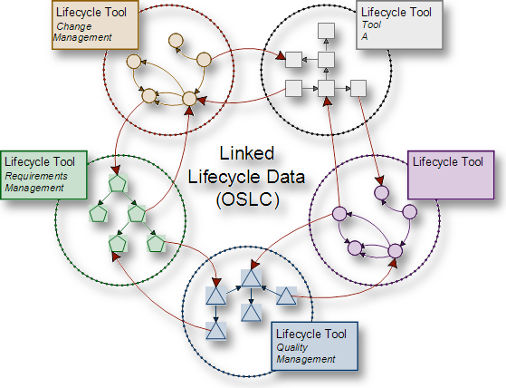

Collaborations in
Software Development
Usability
testing
Requirement
gathering
User centered software process
Implementing
Design/
Prototype
User experience designer
Software engineer
Technical communicator
Usability tester
Project manager
Product owner
Client
User
Cog Walk/
H.E
Notes:
collaboration, interdisciplinary collaboration
1. According to Mathis (2009), a software project manager, stakeholders often complain about the difficulty of building a shared mental model with software engineers, not only because of the interdisciplinary communication barrier, but also because software engineers are often unwilling to invest time and effort into communication as they consider programming to be more important.
2. Software engineers are criticized for their lack of social and communication skills (Leon, 2004).

Slide 3
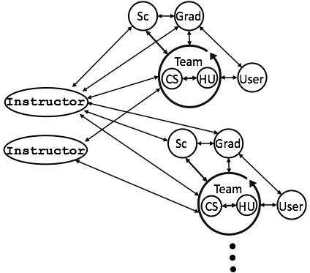
Course Stakeholder Network

Slide 4
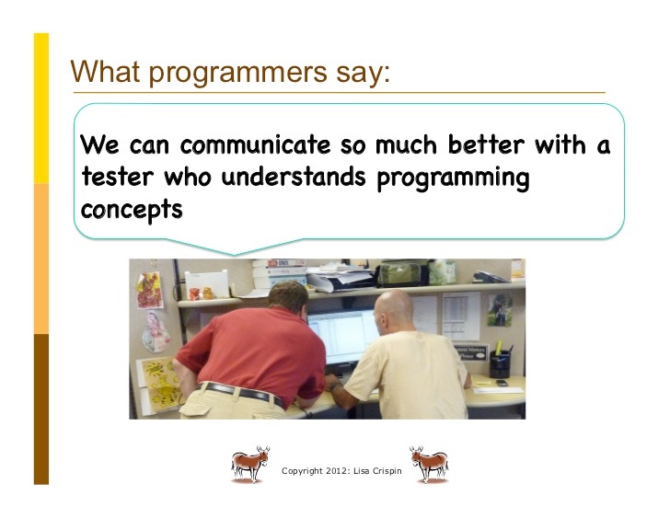
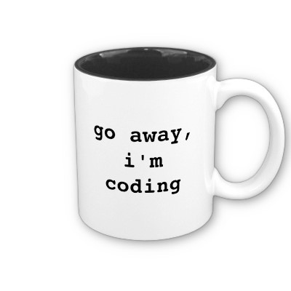
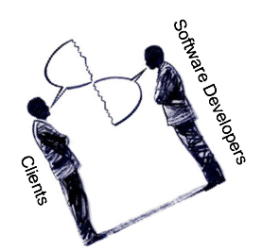
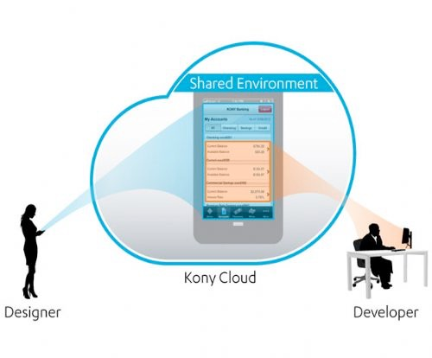
Problems
Usability
testing
Requirement
gathering
User centered software process
Design/
Prototype
Implementing
Cog Walk/
H.E
Notes:
collaboration, interdisciplinary collaboration
1. According to Mathis (2009), a software project manager, stakeholders often complain about the difficulty of building a shared mental model with software engineers, not only because of the interdisciplinary communication barrier, but also because software engineers are often unwilling to invest time and effort into communication as they consider programming to be more important.
2. Software engineers are criticized for their lack of social and communication skills (Leon, 2004).
These problems have led me to seek a way to make software developers work as a team and to facilitate the team’s collaboration with other stakeholders, such as clients.

Slide 5
 | CS students | STC students
Interpersonal conflicts | Need more communication. Need a leader. Some of the teammates did not work a lot. Split the work more evenly. Develop more defined roles for each team member. | Need more communication. Need a leader. Keep the CS and STC students on the same page. CS students did not see the importance of documents from STC students CS students would not show up or speak in the meetings. The clash of personalities between CS and STC members.
Task conflicts | Better delegation of tasks. More time to apply changes from feedback. More time to learn Android development. Earlier development. Disagreement on app design. | Lack of clear expectations on what was to be used in the help documentation.
Team conflicts

Slide 6
 | CS students | STC students
Interpersonal conflicts | Need more communication. Need a leader. Some of the teammates did not work a lot. Split the work more evenly. Develop more defined roles for each team member. | Need more communication. Need a leader. Keep the CS and STC students on the same page. CS students did not see the importance of documents from STC students CS students would not show up or speak in the meetings. The clash of personalities between CS and STC members.
Task conflicts | Better delegation of tasks. More time to apply changes from feedback. More time to learn Android development. Earlier development. Disagreement on app design. | Lack of clear expectations on what was to be used in the help documentation.
Team conflicts

Slide 7
 | CS students | STC students
Interpersonal conflicts | Need more communication. Need a leader. Some of the teammates did not work a lot. Split the work more evenly. Develop more defined roles for each team member. | Need more communication. Need a leader. Keep the CS and STC students on the same page. CS students did not see the importance of documents from STC students CS students would not show up or speak in the meetings. The clash of personalities between CS and STC members.
Task conflicts | Better delegation of tasks. More time to apply changes from feedback. More time to learn Android development. Earlier development. Disagreement on app design. | Lack of clear expectations on what was to be used in the help documentation.
Team conflicts

Slide 8
 | CS students | STC students
Interpersonal conflicts | Need more communication. Need a leader. Some of the teammates did not work a lot. Split the work more evenly. Develop more defined roles for each team member. | Need more communication. Need a leader. Keep the CS and STC students on the same page. CS students did not see the importance of documents from STC students CS students would not show up or speak in the meetings. The clash of personalities between CS and STC members.
Task conflicts | Better delegation of tasks. More time to apply changes from feedback. More time to learn Android development. Earlier development. Disagreement on app design. | Lack of clear expectations on what was to be used in the help documentation.
Team conflicts

Slide 9
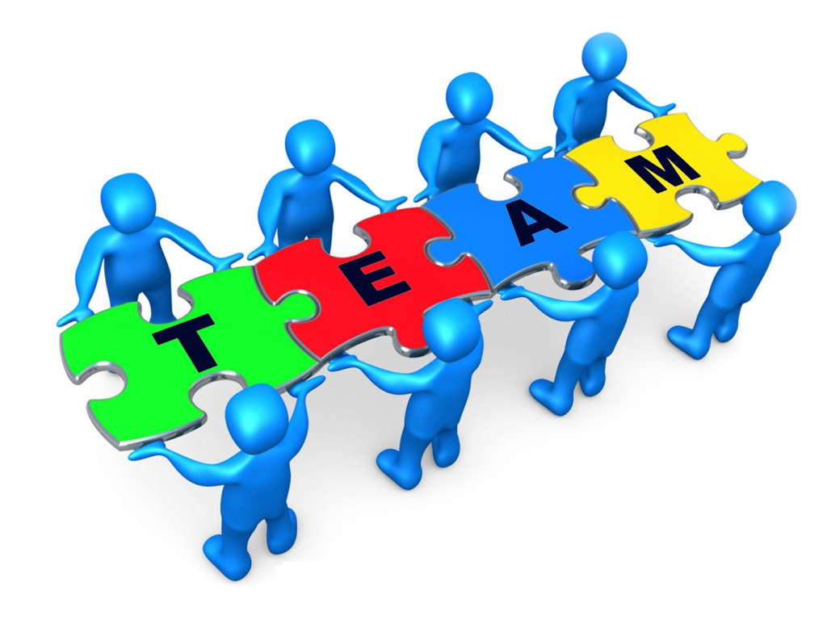

Slide 10
What is a team?
Social entities composed of members with high task interdependency and shared common goals (Dyer, 1984).
A group of people with different specialties linked in a common purpose.
Teamwork: team members integrate and share information, coordinate and cooperate as task demands shift so as to complete their mission.
Common purpose/shared goals:
  Develop app
  Complete the course

Slide 11
What is a team?
Social entities composed of members with high task interdependency and shared common goals (Dyer, 1984).
A group of people with different specialities linked in a common purpose.
Teamwork: team members integrate and share information, coordinate and cooperate as task demands shift so as to complete their mission.
Common purpose/shared goals:
  Develop the app
  Complete the course

Slide 12
What is a team?
Social entities composed of members with high task interdependency and shared common goals (Dyer, 1984).
A group of people with different specialities linked in a common purpose.
Teamwork: team members integrate and share information, coordinate and cooperate as task demands shift so as to complete their mission.
Shared Goals:
  Develop the app
  Complete the course

Slide 13
What are the factors that influence your team collaboration?
Time constraint
Communication
Task coordination
Awareness of the contribution from the other discipline
Personalities

Slide 14
Team Building Techniques
Getting to know each other
Create shared/common goals
Build a team structure
Develop a team process

Slide 15
Getting to know each other:
Know your team member’s name
Know what each person is good at
Find a role for yourself and others in the team

Slide 16
Shared/Common Goals:
Project goal: what are you ultimately trying to accomplish?
Course goal: get an A or comfortable workload?
Write a team vision statement

Slide 17
Building a Team Structure
Smaller team have team leaders.
Team leader roles:
  Organize and lead meetings
  Split the project into tasks
  Monitor the project and Keep team members on track
  Monitor the team process and improve the process

Slide 18
Team Processes:
Communication: Meetings & Emails
  Email: subject line, responsiveness
  Meeting: Define meeting goals
  Tasking more appropriate during meetings
  Difficulties and seeking help
  Work jams for getting the project done.
Monitoring Progress
  Development timeline
  Burnt down chart
Notes:
Most teams start out ok, and then drift away from their original goals and eventually fall apart.

Slide 19
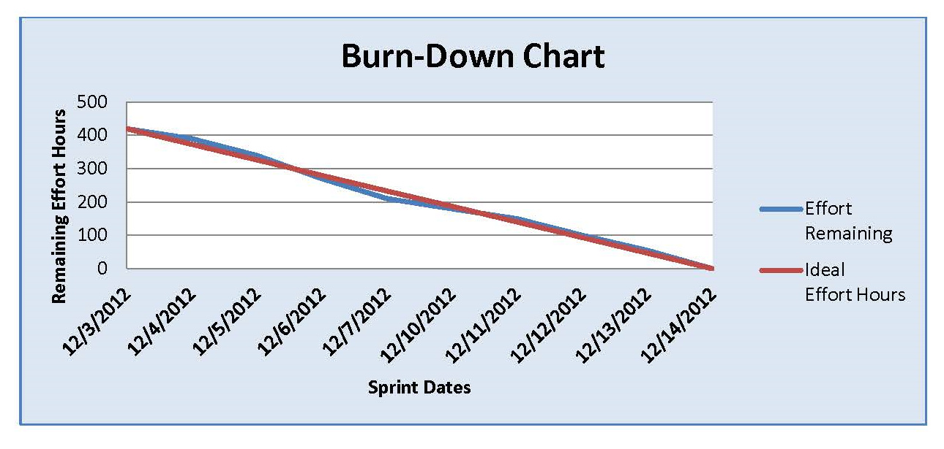
Team Process
Communication: Meetings & Emails
  Email subject line
  Meeting goals
  Tasking
  Difficulties
Progress
  Burnt down chart
  Development timeline
Notes:
Most teams start out ok, and then drift away from their original goals and eventually fall apart.

